Slide 1
The Library of Alexandria
29 August 2016

Slide 2
THE JURY

Slide 4
JURY REPORT

Slide 5
WINNING PROJECTS

Slide 6
FIRST PRIZE WINNER Project code: 026-XQ7439 WestonWilliamson + Partners

Slide 7
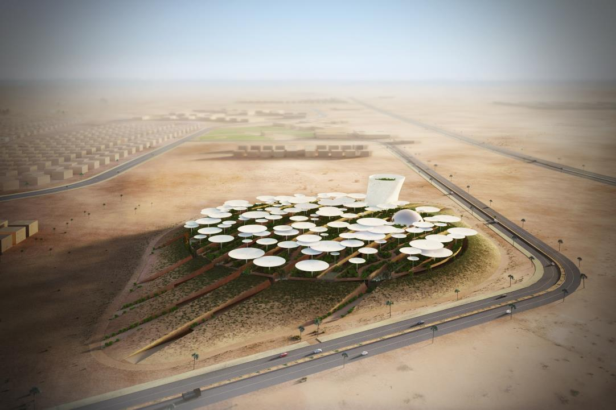

Slide 8
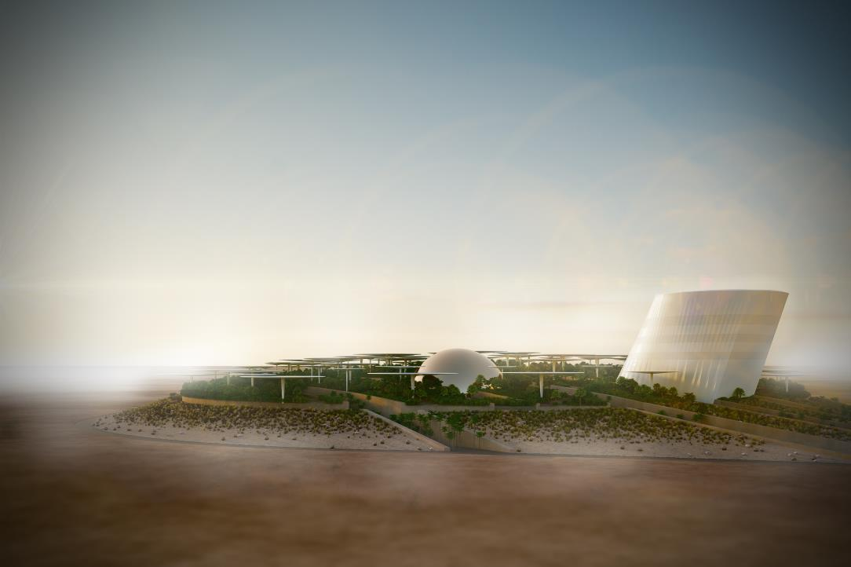
XQ7439_IMG_12.jpg

Slide 9
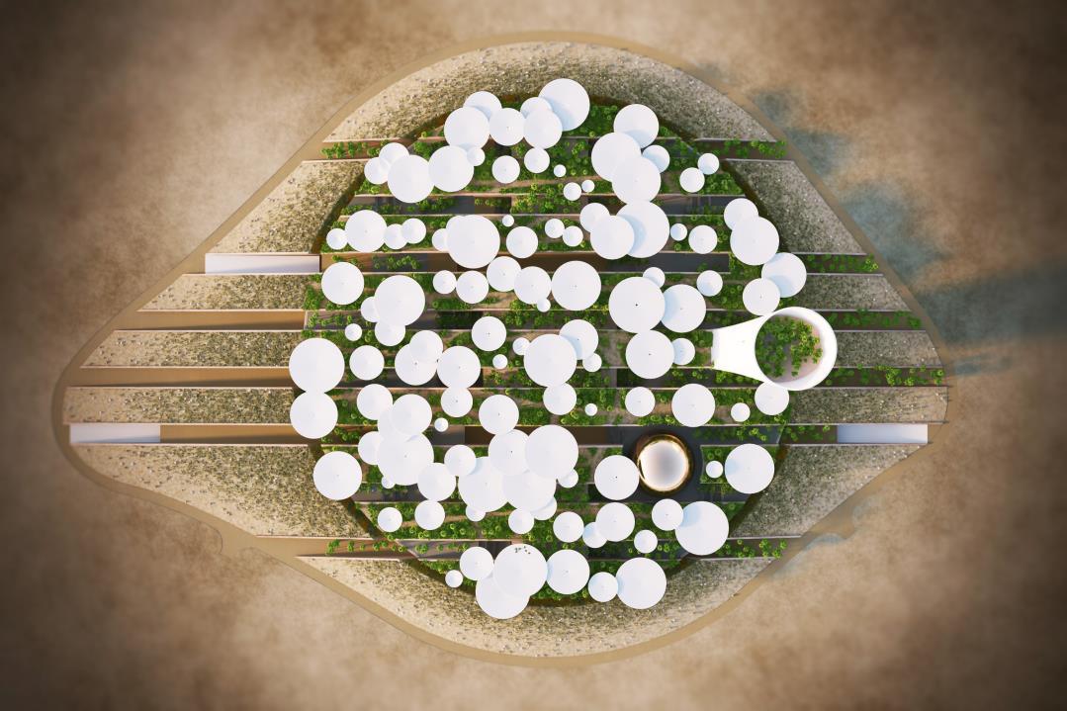

Slide 11
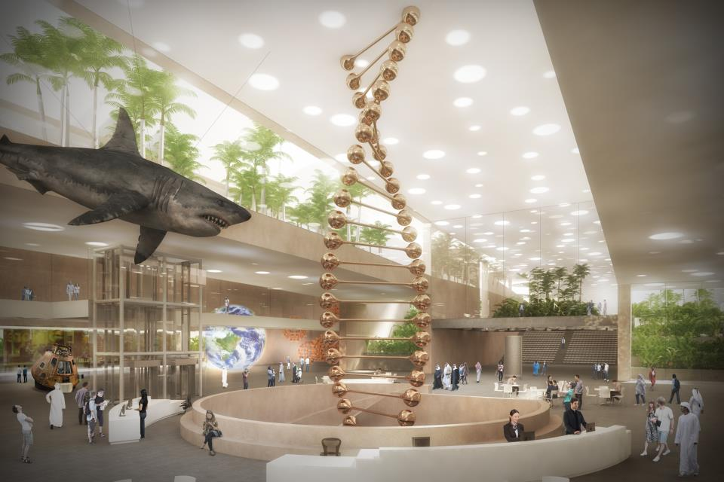

Slide 12
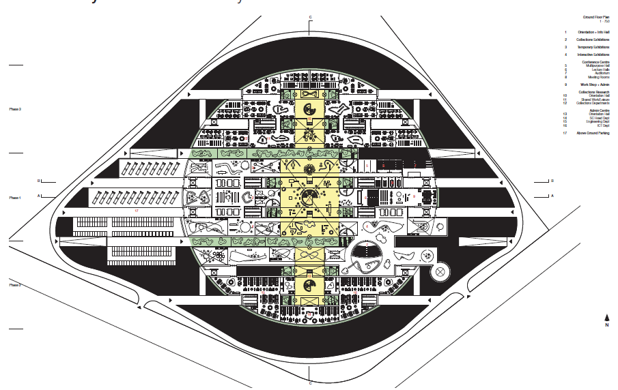

Slide 13
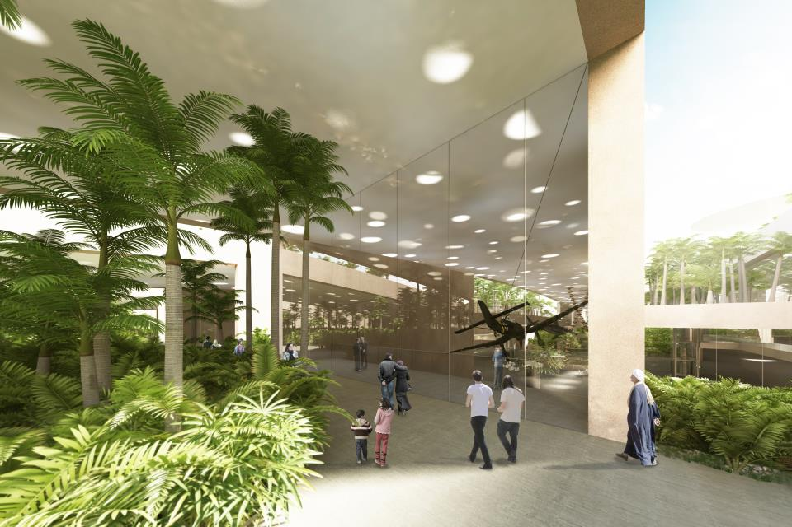

Slide 14
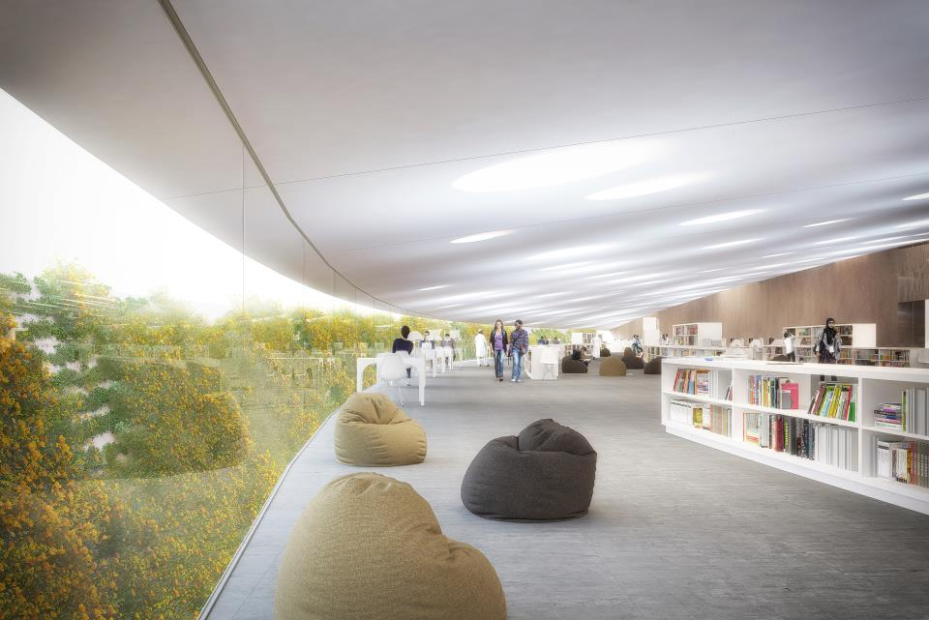

Slide 15
SECOND RANK PRIZE Project code: 007-NP1128 Ngiom Partnership

Slide 16
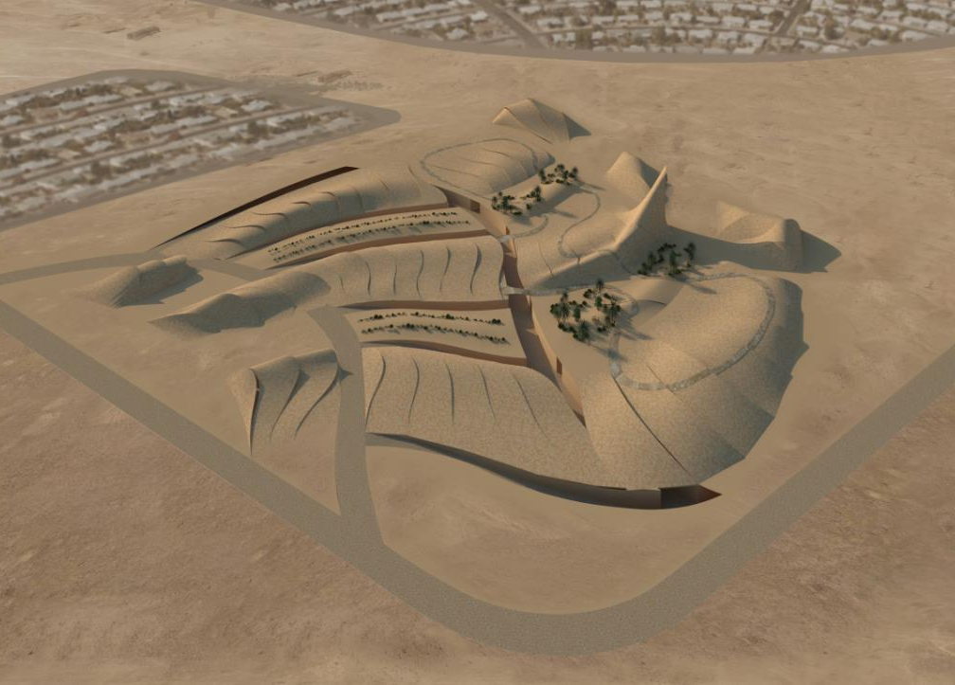

Slide 21
THIRD RANK PRIZE Project code: 013-BA0816 Zaha Hadid Architects

Slide 22
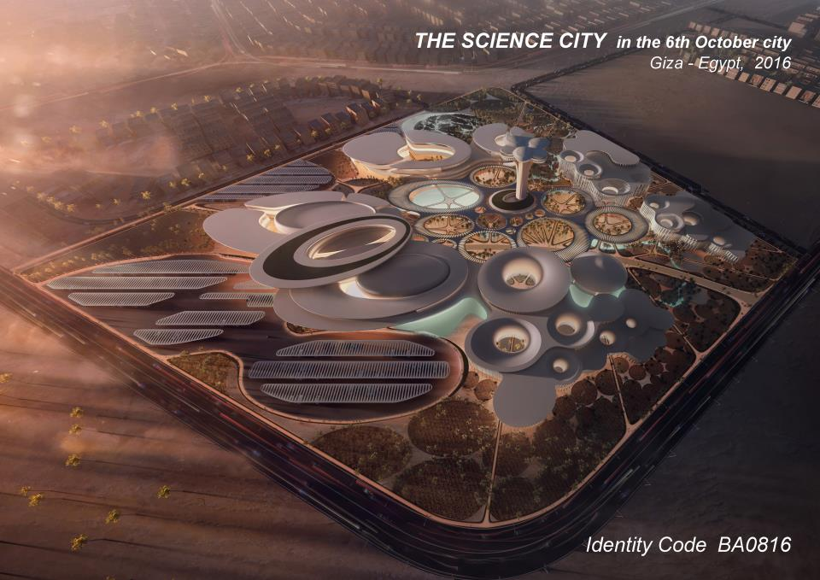

Slide 23
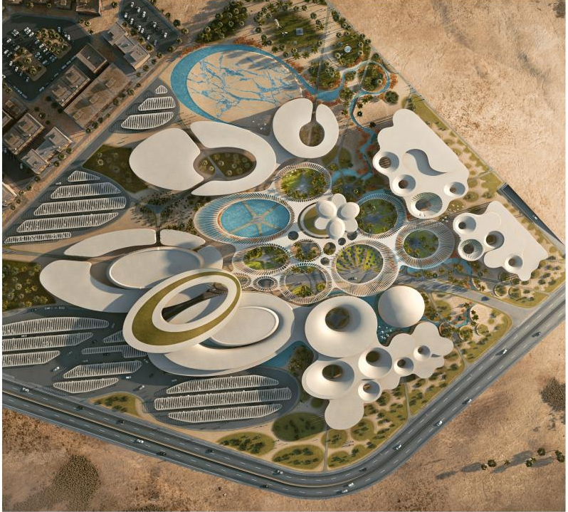

Slide 24
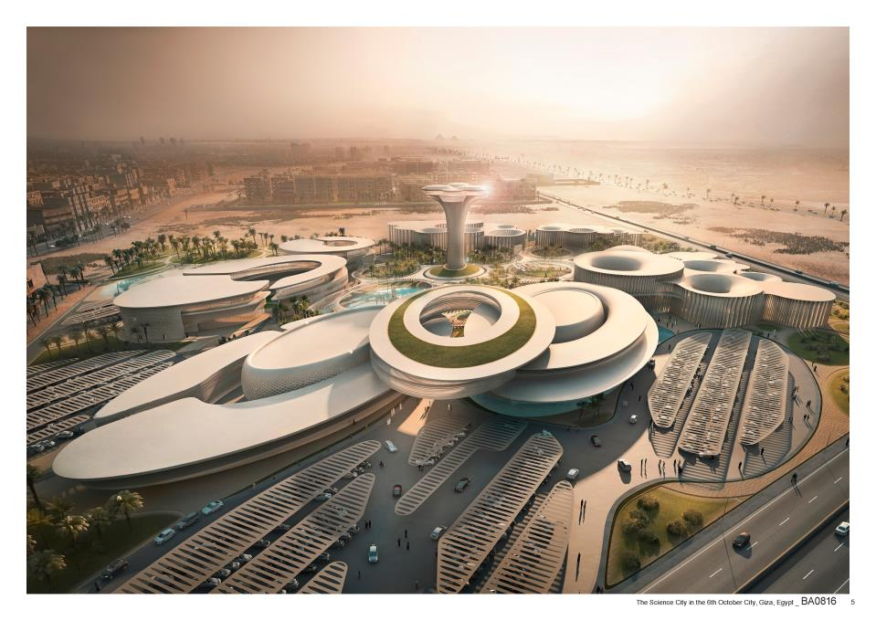

Slide 25
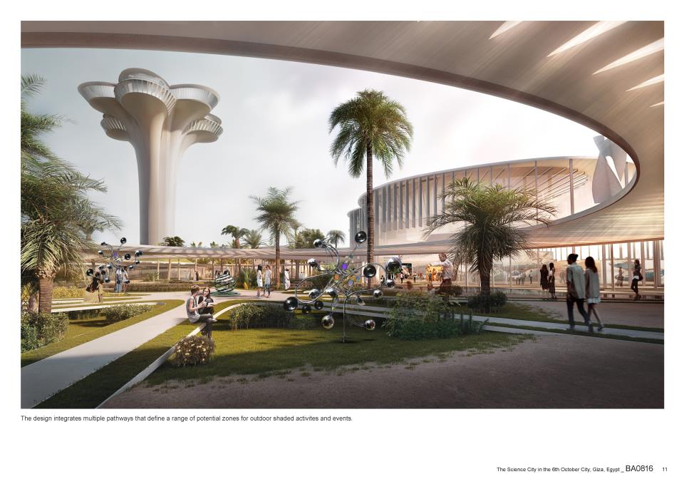

Slide 26
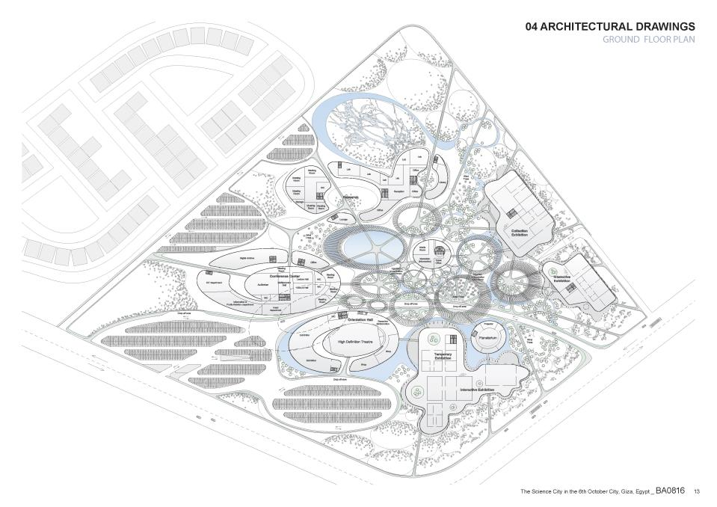

Slide 27
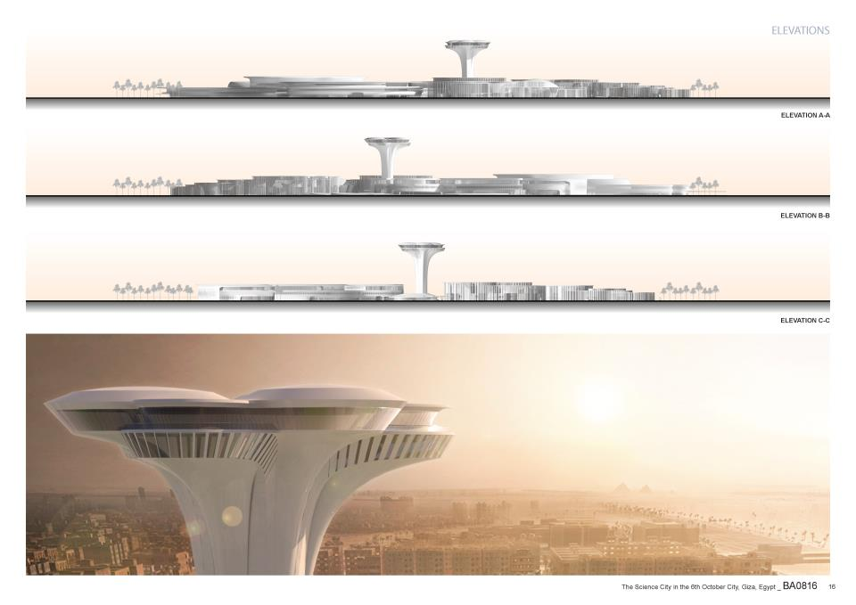

Slide 28
FOURTH RANK PRIZE Project code: 005-GS9810 Gansam Architects & Partners Co.,Ltd

Slide 29
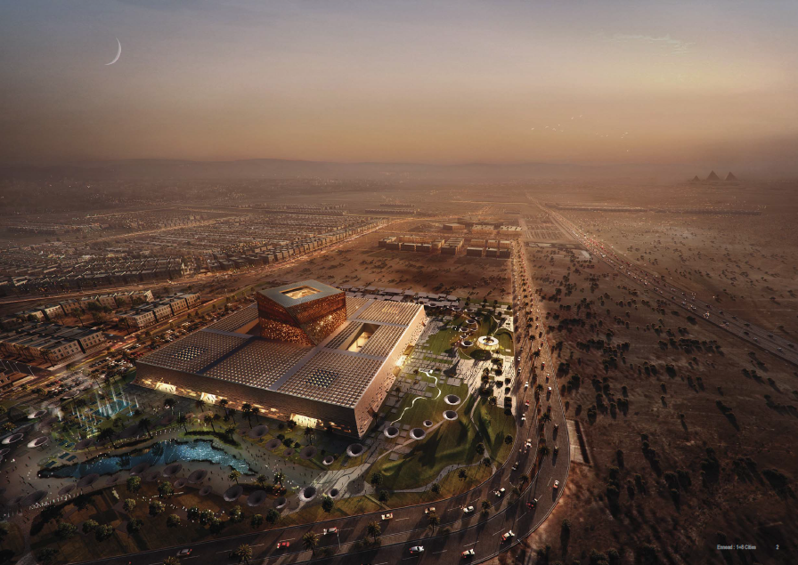

Slide 30
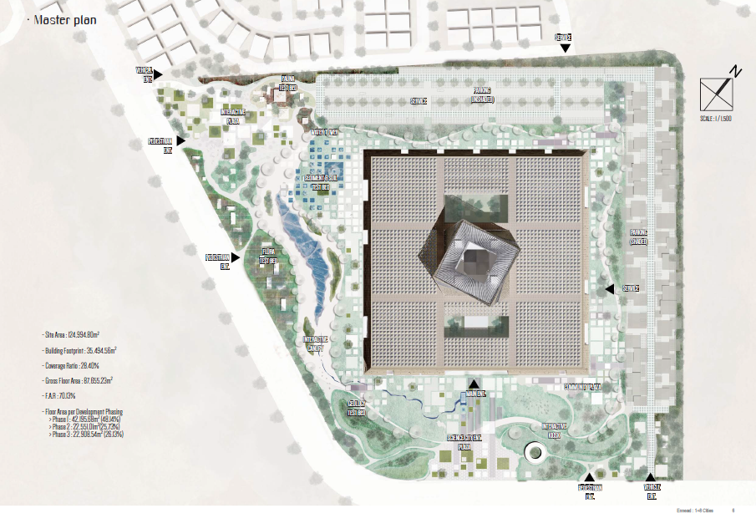

Slide 31
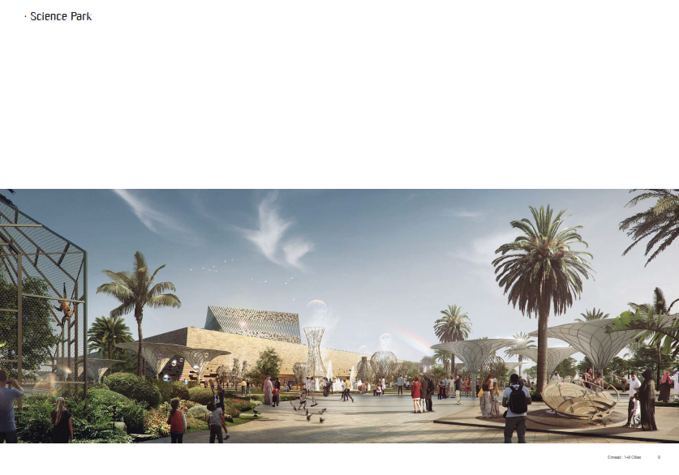

Slide 32
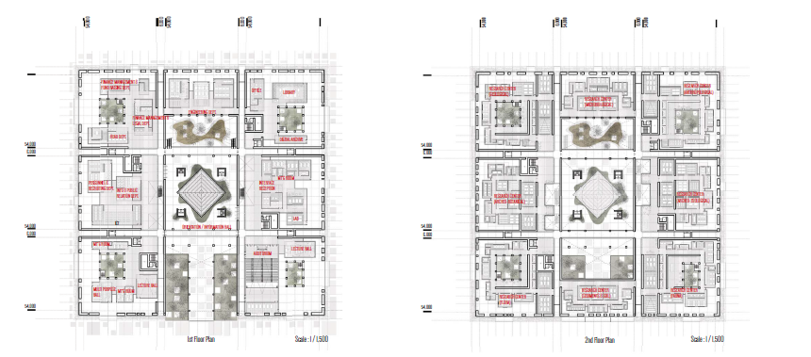

Slide 33
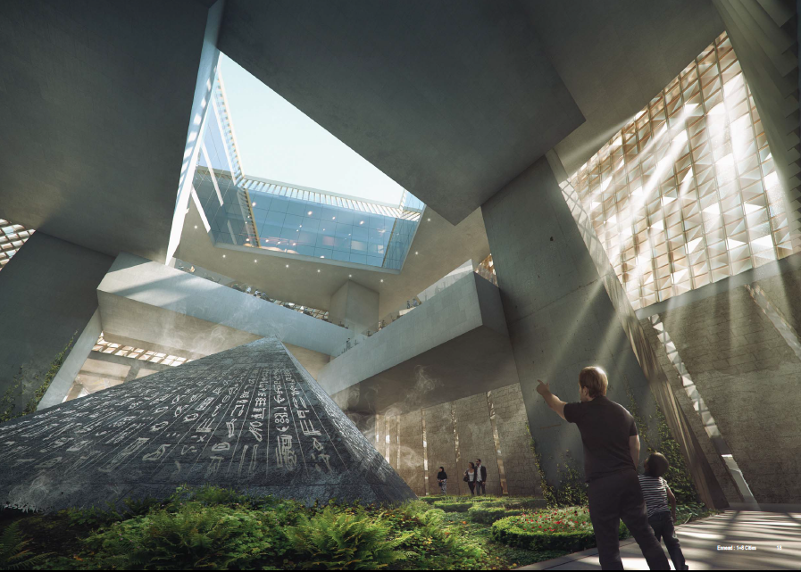

Slide 34
MENTION PRIZE Project code: 020-AN6343 Tsampikos Petras, Georgios Chousos

Slide 35
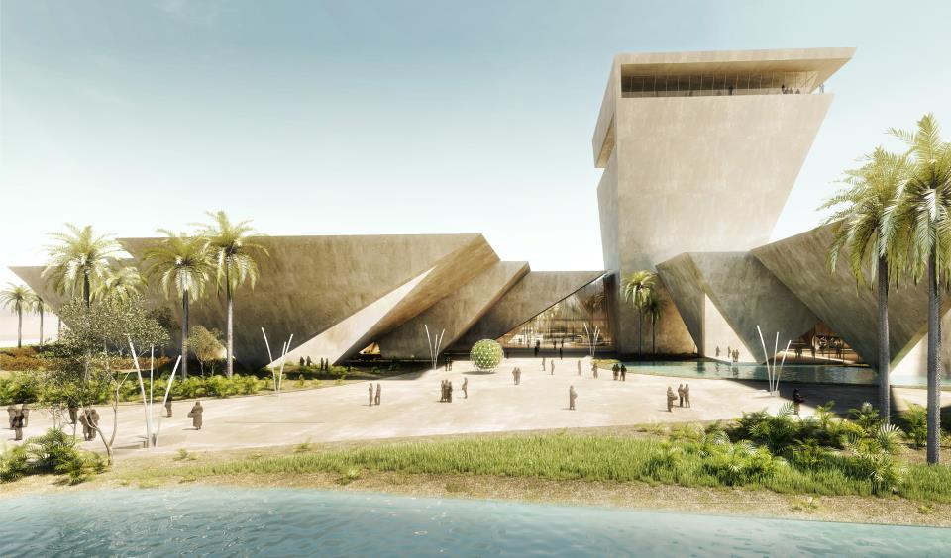

Slide 36
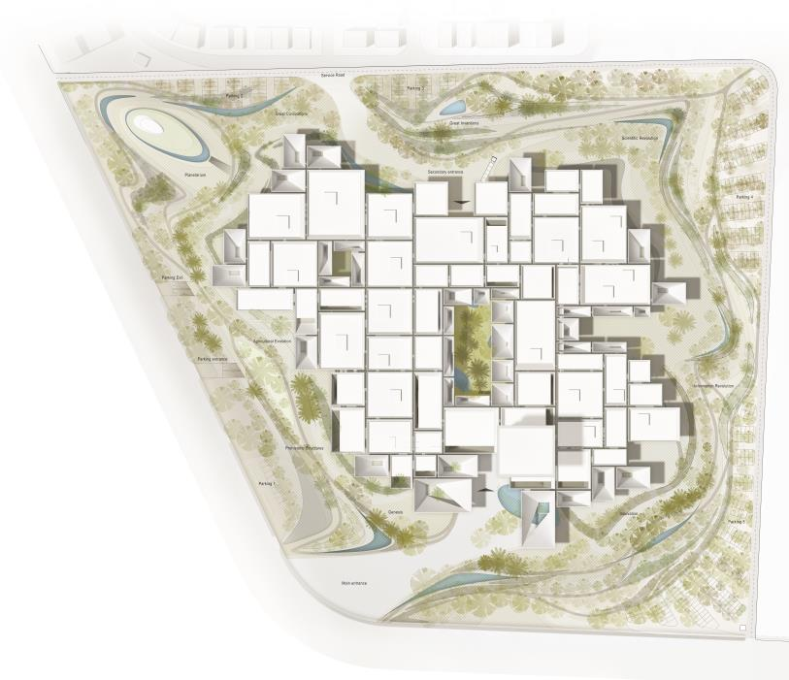

Slide 38
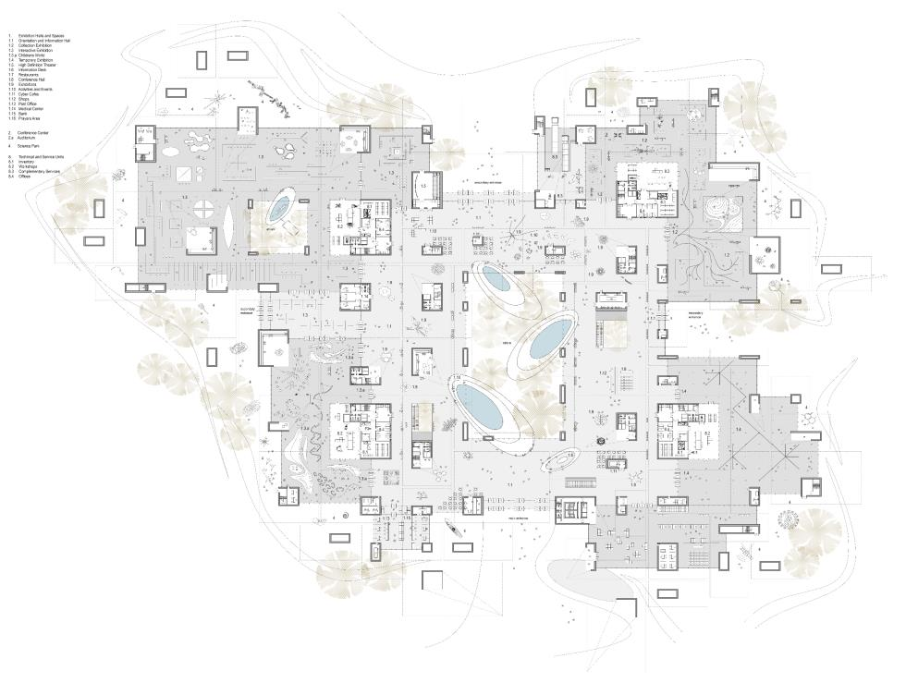

Slide 40
MENTION PRIZE Project code: 034-NP7215 Joaquim Caetano de Lima Filho, Daniel Henrique Ribeiro, Giliarde Silva, Guilherme Oliveira, Lucas Moretti, Raissa Shizue.

Slide 41
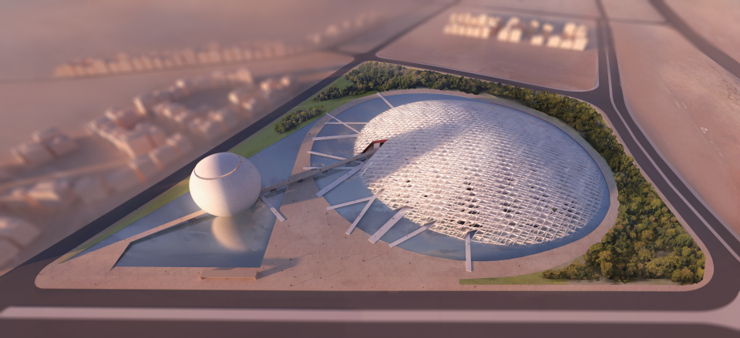

Slide 42
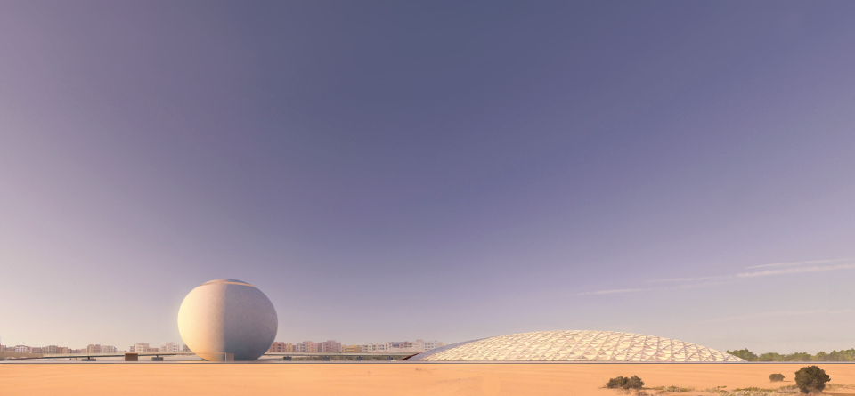

Slide 43
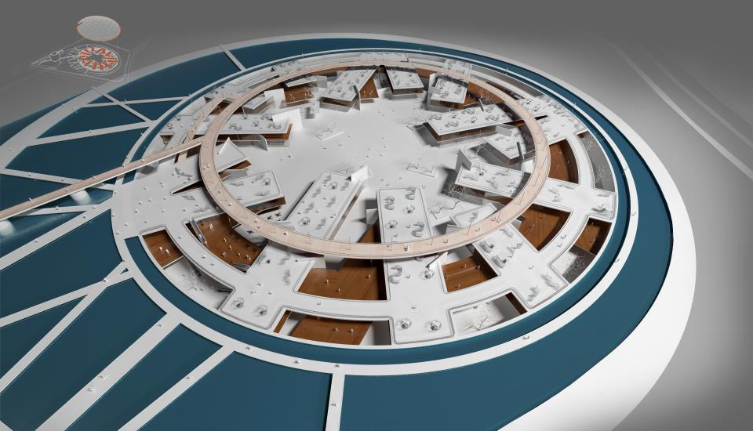

Slide 44
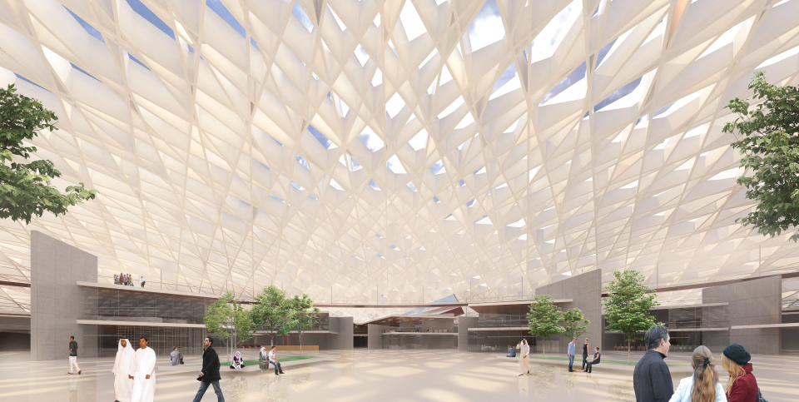

Slide 45
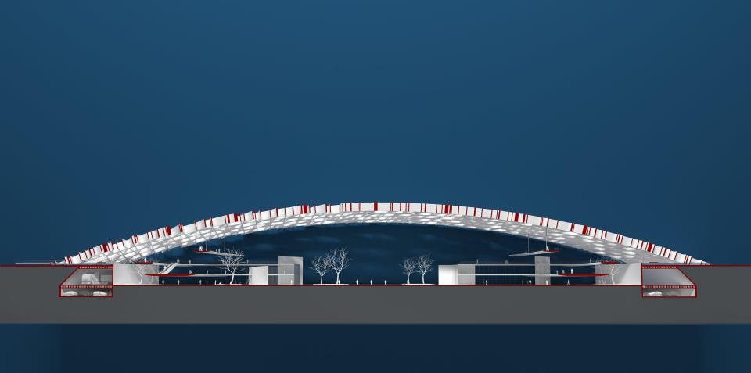

Slide 46
MENTION PRIZE Project code: 014-MM4891 Francisco Jorquera

Slide 47
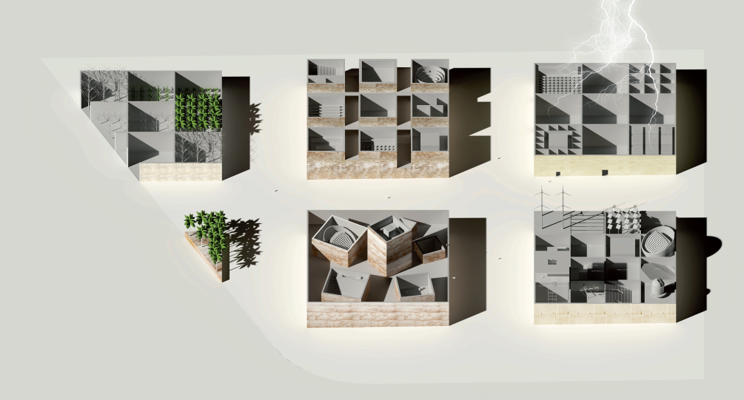

Slide 48
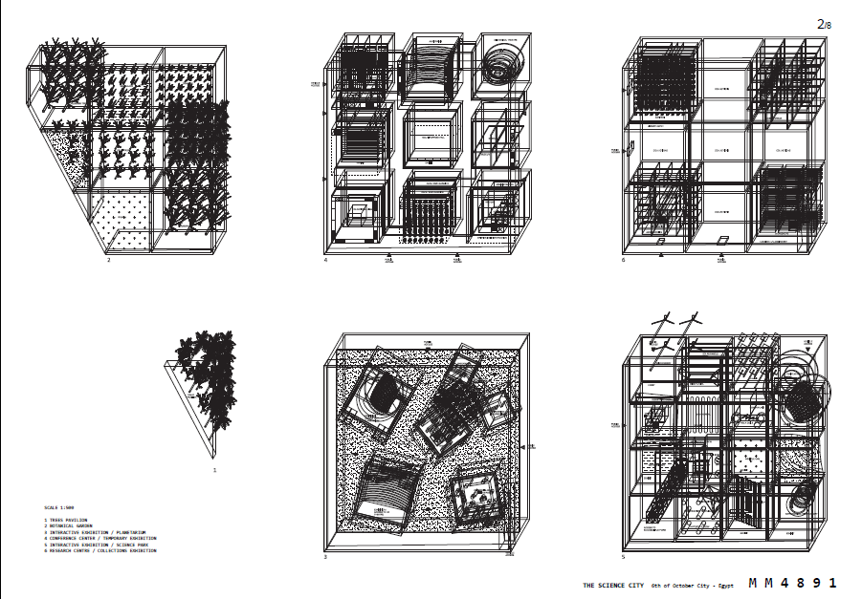

Slide 49
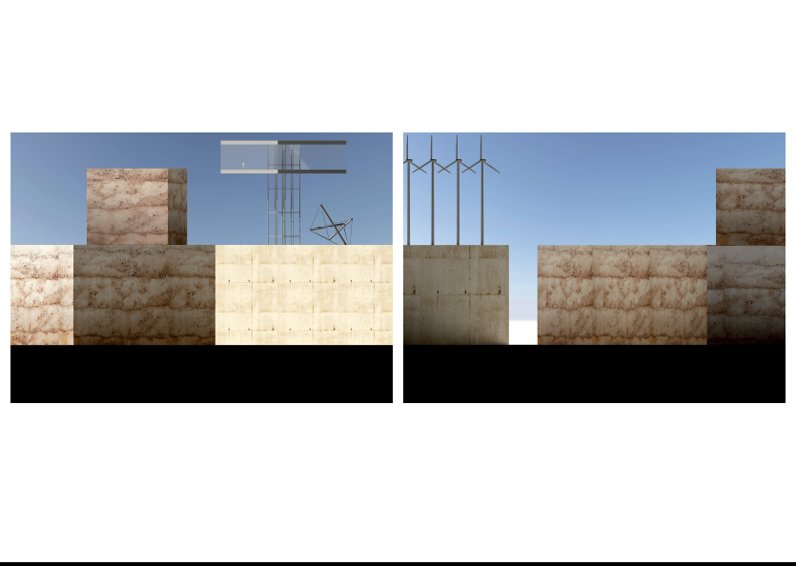

Slide 50
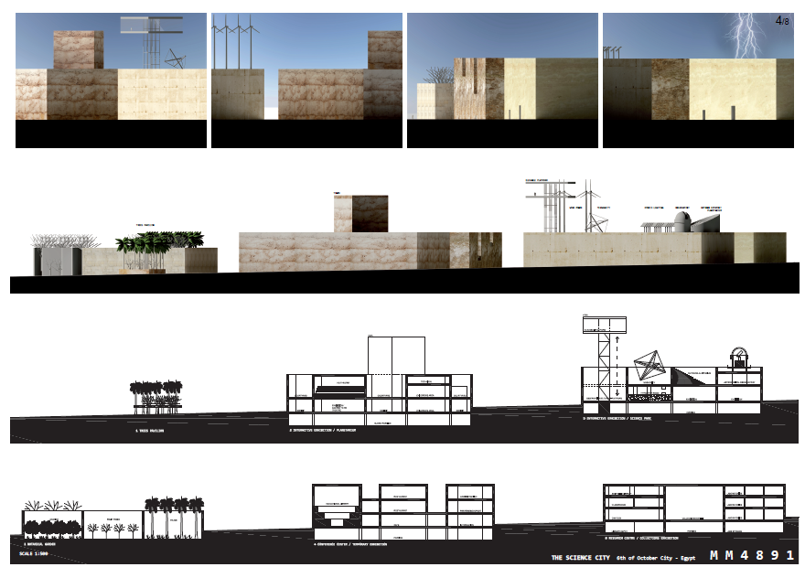

Slide 51
MENTION PRIZE Project code: 049-ST2347 whitespace architects

Slide 52
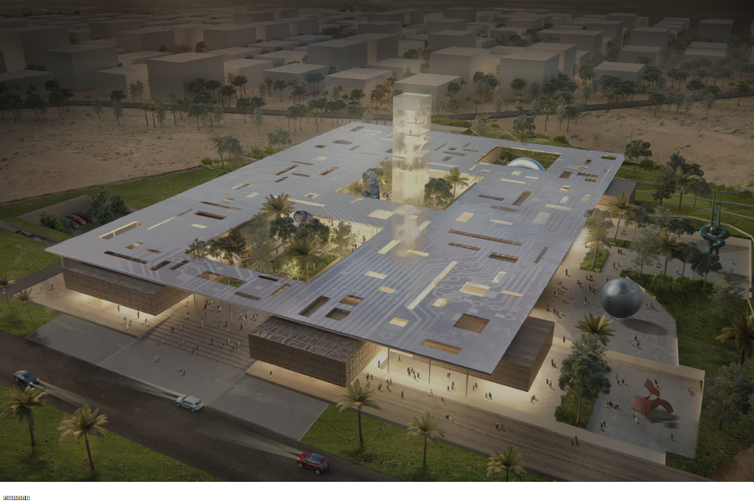

Slide 53
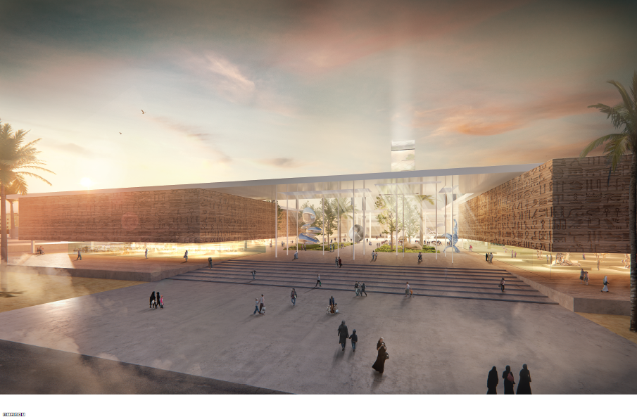

Slide 54
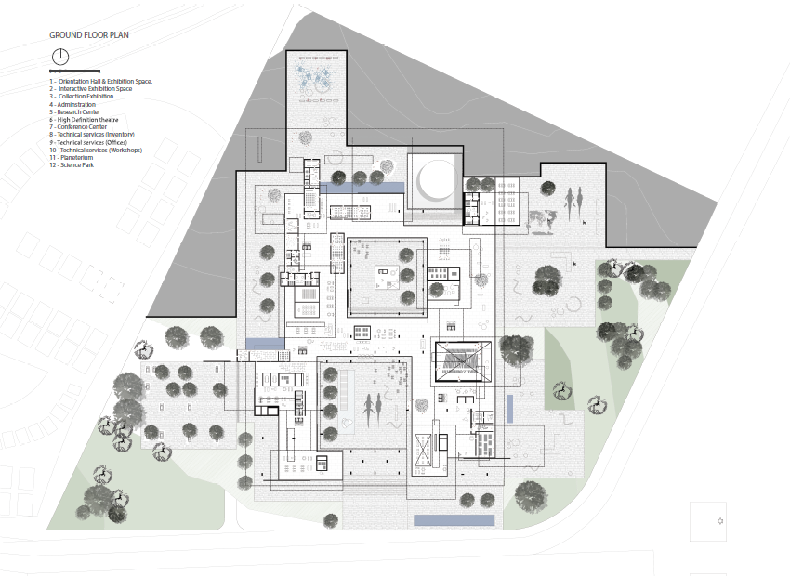

Slide 55
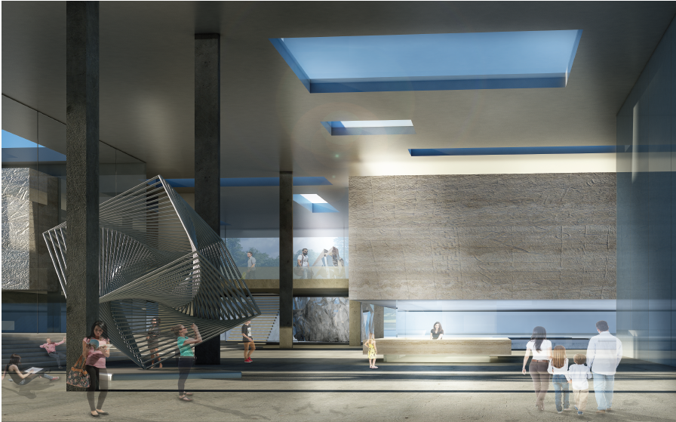

Slide 56
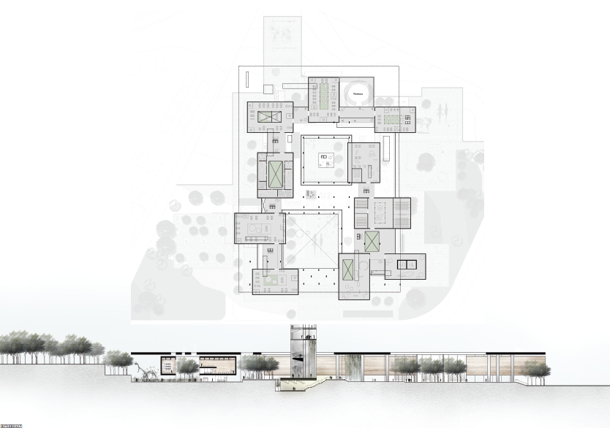

Slide 57
The Library of Alexandria
29 August 2016

