Slide 1
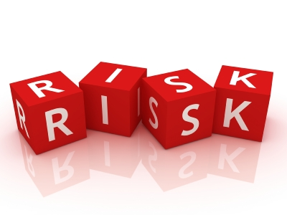
Fahd adel_Tarek aly
Risk assessment تقييم المخاطر

Slide 2
What is :

Slide 3
Simply _:
probability
consequence
RISK

Slide 5
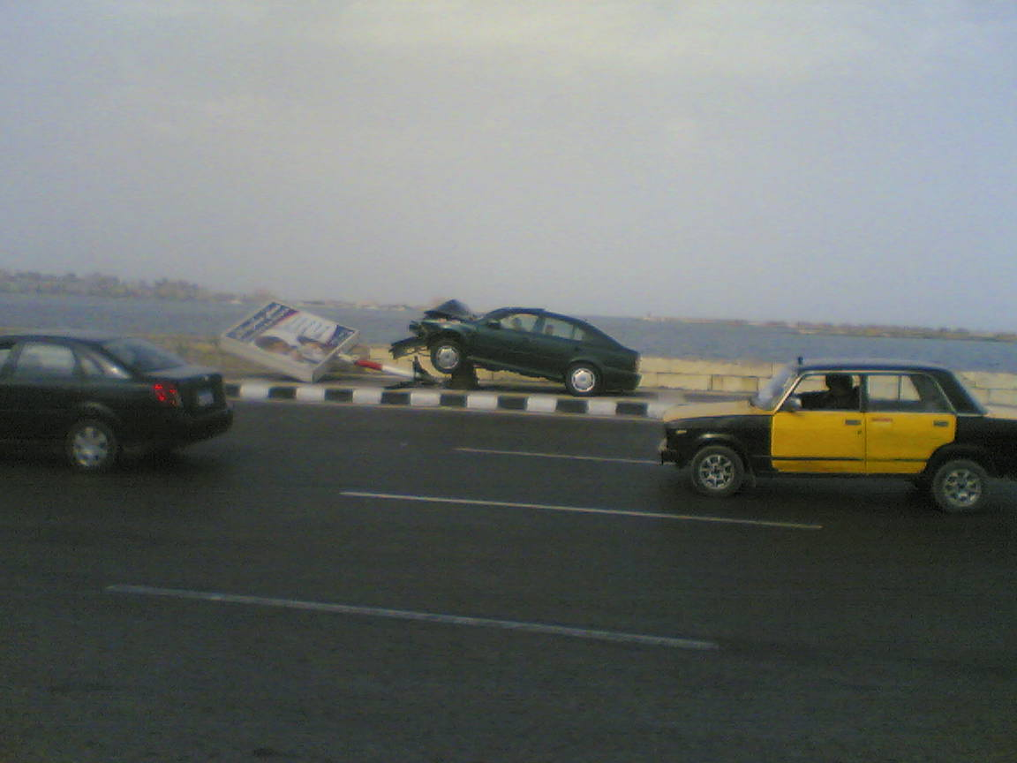
probability

Slide 6
consequence

Slide 7
people loss

Slide 8
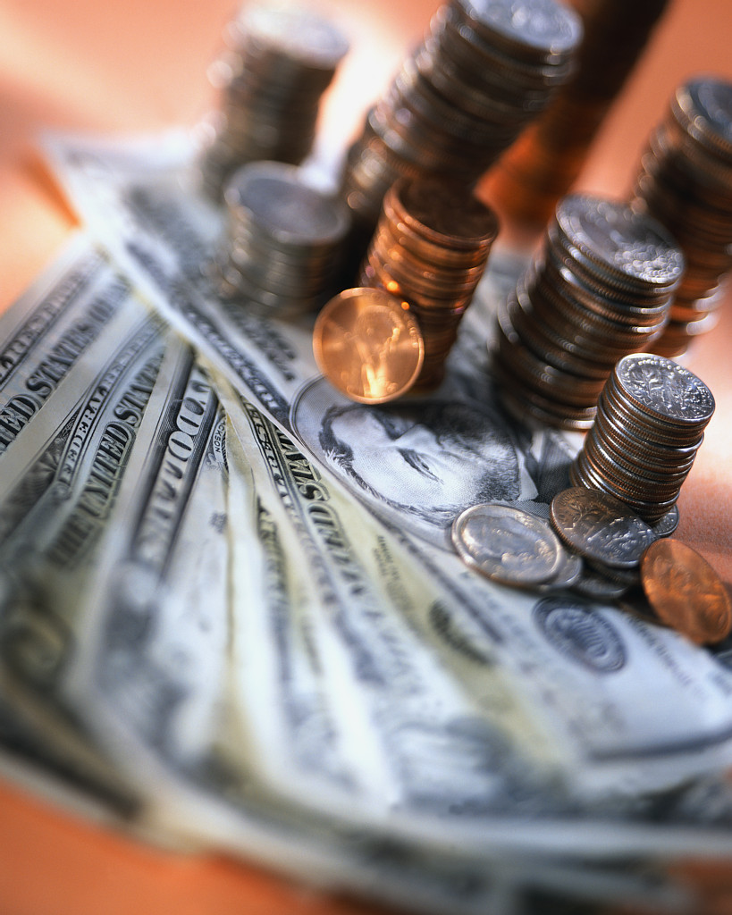
financial losses

Slide 9
Enviromental polluation:

Slide 10
reputation

Slide 11
time

Slide 12
benefits
1_reduce errors
2_alternative ways to solve the problem
3_save money and time

Slide 13
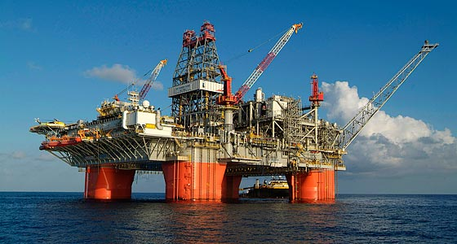
Application
work

Slide 14
Like fACTORIES

Slide 15
buildings

Slide 16
OIL COMPANIES

Slide 17
EDUCATION

Slide 18
CHEMICALS

Slide 19
TRUE EXAMPLE

Slide 20
RESULT

Slide 22
MEDIA

Slide 23
PEOPLE _SAD

Slide 24
refrences
wikipedia.com
Risk assesment leader_book
True line.com
Earth4all.com

