Slide 1
Chase your dreams
By: fatema taha shuwaikh

Slide 2
The goal of this session
Catch a dream or even dreams, then try as hard as you can to achieve them.
After this session

Slide 3
You become what you think about at the most of the time

Slide 4
How to dream ! How to make them come true !
The best criteria in human being is the ability to dream.
The most impressive about this ability is that we can transform it into reality !

Slide 5
Steps to make a dream a reality
Nothing matters but this moment and what you are focusing your attention on.

Slide 6

Step 1: Lose the negative attitude, Think positively
  The mind must believe it can do something before it is capable of actually doing it.
  Negative thinking creates negative results.
  Positive thinking creates positive results.

Slide 7


Step 2: Figure out what you really want out of life
Some of us were born to be musicians to communicate thoughts and feelings with the strings of a guitar.
Some of us were born to be entrepreneurs to create growth and opportunity where others saw rubbish.
And still, some of us were born to be or do whatever it is, specifically, that moves you.
Don’t waste your life fulfilling someone else’s dreams and desires. You must follow your intuition and make a decision.

Slide 8
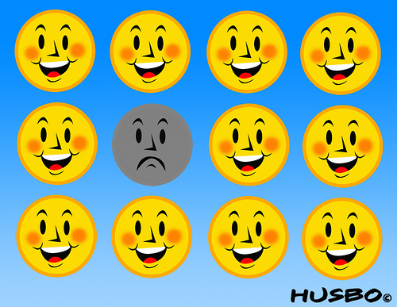

3- Surround yourself with great people
You are the sum of the people you spend the most time with. If you hang with the wrong people, they will negatively affect you. But if you hang with the right people, you will be far more capable and powerful than you ever could have been alone.

Slide 9
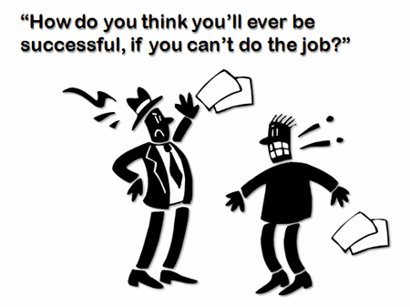

4- Work on it for real.
The harder you work the luckier you will become
Remember, life is not easy, especially when you plan on achieving something .
Achieving your dreams can be a lot of work. Be ready for it.

Slide 10

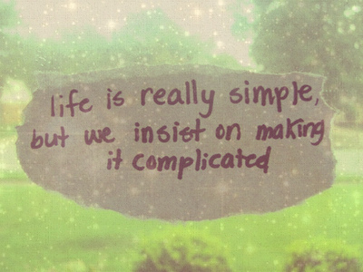

5- Don’t make life harder than it needs to be.
As Oscar Wilde once said, “Life is not complex. We are complex. Life is simple, and the simple thing is the right thing.

Slide 11
step 6: Exploit the resources you do have access to.
It’s not about having the right resources;
it’s about exploiting the resources you do have access to.
Stevie Wonder couldn’t see,
so he exploited his sense of hearing into a passion for music,
and he now has 25 Grammy Awards to prove it.
Get it?

Slide 12
Step 7:Don’t avoid things you don’t understand.
Right now there’s a lot you don’t know.
No matter how smart you are or how much you learn there will always be more to learn.
Hiding from what you don’t know will bury you right beside your dreams.
So embrace the things you don’t understand and study them.
Achieving this understanding is what living your life is all about.
Be smarter

Slide 13
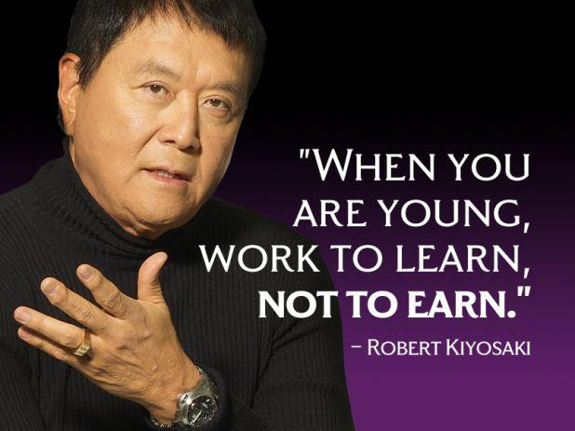
?
Why?

Slide 14

Step 8: Ignore negative naysayers.
When you receive negative feedback, remember, it doesn’t matter how many people don’t get it, it matters how many do.
Still, no matter how much progress you make there will always be the people who insist that whatever you’re trying to do is impossible

Slide 15

When you come across these people, don’t try to reason with them. Instead, forget that they exist. They will only waste your time and energy.
Go through your way !

Slide 16
Step 9: Take good care of your body and your brain.
Your body is the greatest tool you’ll ever own.
It impacts every step you take and every move you make. You won’t get anything done without it.
The human brain only accounts for roughly 2% of the total mass of the human body,
yet it consumes over 20% of the oxygen and nutrients the human body intakes.
So nourish your body, exercise it and rest it appropriately

Slide 17

Step 10: Work on your dreams when you first awake.
The mornings are a fresh start, peaceful and free of random mid-day distractions.
So put your dreams first. Even if you only have time to work on them for 30 minutes each morning, do it.
It truly makes all the difference in the world.
Each day, no matter what else happens, you will have done something to make your dreams come true.

Slide 18
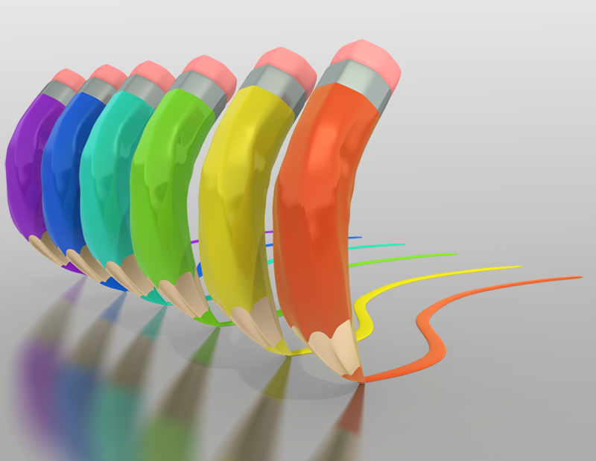
write down your dreams , and wait for my next session ☺

Slide 19


Suggested movies to get inspired
Life as a house
Temple grandin

Slide 20
References :
Marc and angle hack life
http://www.marcandangel.com/
Free self help tutorials
http://www.best-self-help-sites.com/index.html
Positively positive
http://www.positivelypositive.com
Pick the brain
http://www.pickthebrain.com

Slide 21




My contact information
fatma.taha@yahoo.com
https://www.facebook.com/btshuwaikh
Thanks for being there ☺

