Slide 1
  Theory of dimensions.
By :Omar Ahmed Elalfey.

Slide 2
Problem with Nature of Light.
Isaac Newton: Suppose light particulate his theory.
Christian Huygens: He was a strong supporter of the wave nature of light.
Max Planck: Suppose that the light travels in the form of quanta of energy.
Albert Einstein: The expansion of this theory and the imposition of the characteristics of the dual nature of light photons.

Slide 3
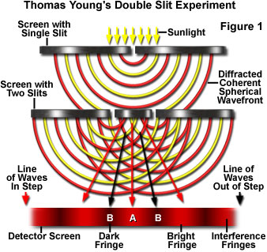
Double-slit Experiment.

Slide 4
Hypothesis:
1-Relative bending assumption.
Deflection of moving objects in relation to each other, including so-called bow regardless of the relative measurements of the observer or any external influential force.
2-Self-bending assumption.
Deflection of moving objects on the self-same degree of Anhanaúha vary according to the speed of (positive relationship), regardless of the observer measurements or any external influential force.

Slide 5
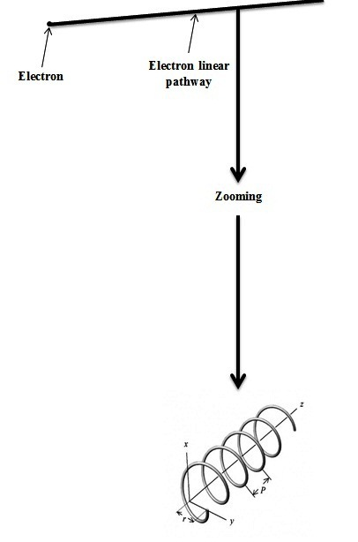
Self-bending assumption.

Slide 6
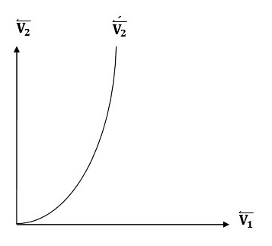
Relative bending assumption.

Slide 7
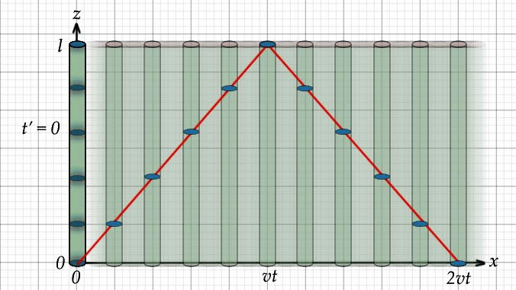
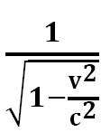
Lorentz factor.

Slide 8
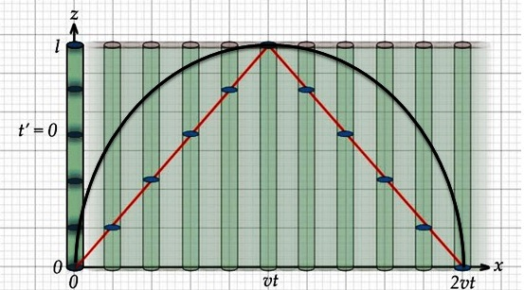
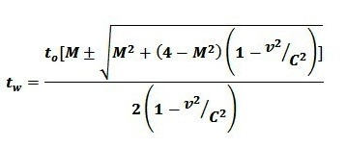
Modify the Lorentz factor.

Slide 9
Time dilation equation.
1-According to theory of dimensions :
2-According to special relativity:

Slide 10
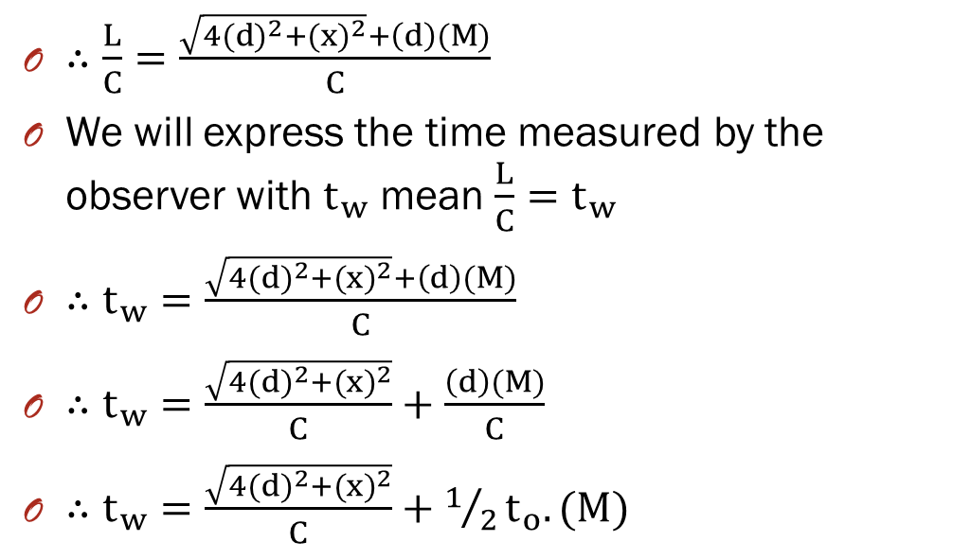
Mathematically prove of the .equation
$∴\frac{L}{C}=\frac{\sqrt{4{(d)}^{2}+{(x)}^{2}}+\left(d\right)(M)}{C}$
We will express the time measured by the observer with $t_{w}$ mean $\frac{L}{C}=t_{w}$
$∴t_{w}=\frac{\sqrt{4{(d)}^{2}+{(x)}^{2}}+\left(d\right)(M)}{C}$
$∴t_{w}=\frac{\sqrt{4{(d)}^{2}+{(x)}^{2}}}{C}+\frac{\left(d\right)(M)}{C}$
$∴t_{w}=\frac{\sqrt{4{(d)}^{2}+{(x)}^{2}}}{C}+1/2t_{o}.(M)$

Slide 11
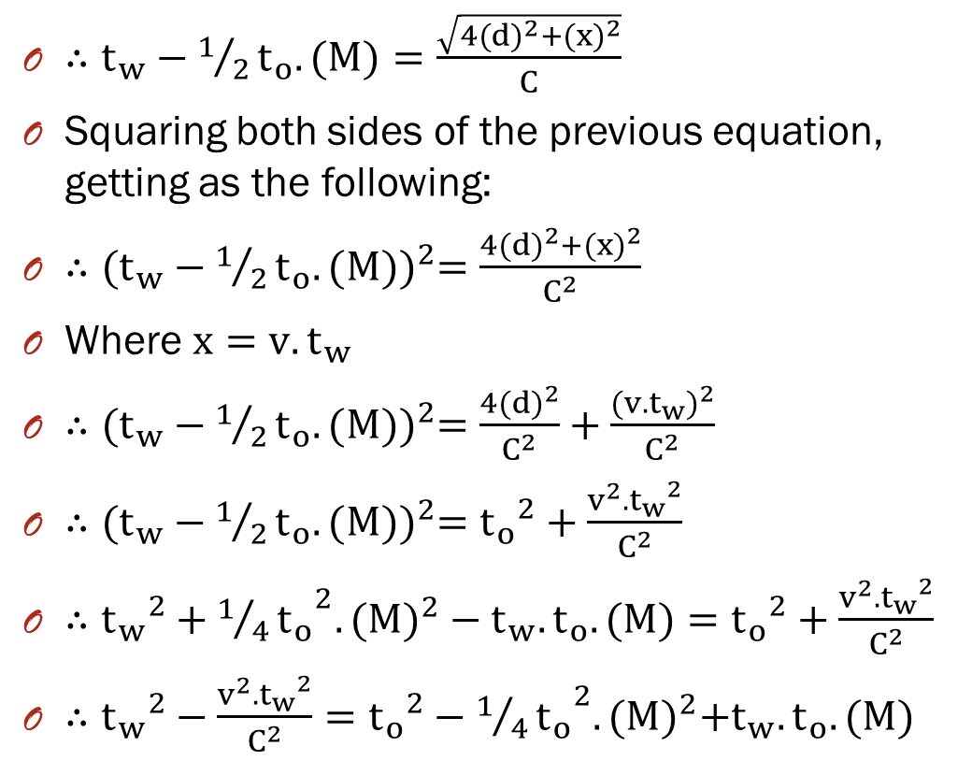
$∴t_{w}−1/2t_{o}.(M)=\frac{\sqrt{4{(d)}^{2}+{(x)}^{2}}}{C}$
Squaring both sides of the previous equation, getting as the following:
$∴{(t_{w}−1/2t_{o}.(M))}^{2}=\frac{4{(d)}^{2}+{(x)}^{2}}{C^{2}}$
Where $x=v.t_{w}$
$∴{(t_{w}−1/2t_{o}.(M))}^{2}=\frac{4{(d)}^{2}}{C^{2}}+\frac{{(v.t_{w})}^{2}}{C^{2}}$
$∴{(t_{w}−1/2t_{o}.(M))}^{2}={t_{o}}^{2}+\frac{v^{2}.{t_{w}}^{2}}{C^{2}}$
$∴{{t_{w}}^{2}+{1/4t_{o}}^{2}.(M)}^{2}−t_{w}.t_{o}.(M)={t_{o}}^{2}+\frac{v^{2}.{t_{w}}^{2}}{C^{2}}$
$∴{t_{w}}^{2}−\frac{v^{2}.{t_{w}}^{2}}{C^{2}}={t_{o}}^{2}−{1/4t_{o}}^{2}.{(M)}^{2}+t_{w}.t_{o}.(M)$

Slide 12
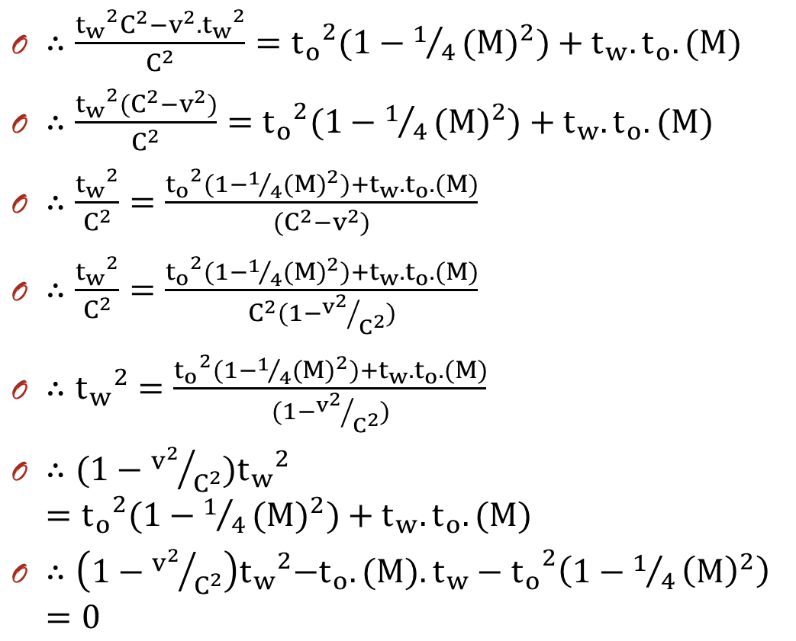
$∴\frac{{{t_{w}}^{2}C^{2}−v}^{2}.{t_{w}}^{2}}{C^{2}}={t_{o}}^{2}(1−1/4{(M)}^{2})+t_{w}.t_{o}.(M)$
$∴\frac{{{t_{w}}^{2}{(C}^{2}−v}^{2})}{C^{2}}={t_{o}}^{2}(1−1/4{(M)}^{2})+t_{w}.t_{o}.(M)$
$∴\frac{{t_{w}}^{2}}{C^{2}}=\frac{{t_{o}}^{2}(1−1/4{(M)}^{2})+t_{w}.t_{o}.(M)}{{{(C}^{2}−v}^{2})}$
$∴\frac{{t_{w}}^{2}}{C^{2}}=\frac{{t_{o}}^{2}(1−1/4{(M)}^{2})+t_{w}.t_{o}.(M)}{C^{2}(1−{v^{2}}/{C^{2}})}$
$∴{t_{w}}^{2}=\frac{{t_{o}}^{2}(1−1/4{(M)}^{2})+t_{w}.t_{o}.(M)}{(1−{v^{2}}/{C^{2}})}$
$∴(1−{v^{2}}/{C^{2}}){t_{w}}^{2}={t_{o}}^{2}(1−1/4{(M)}^{2})+t_{w}.t_{o}.(M)$
$∴\left(1−{v^{2}}/{C^{2}}\right){t_{w}}^{2}{{−t_{o}.(M).t_{w}−t}_{o}}^{2}\left(1−1/4{\left(M\right)}^{2}\right)=0$

Slide 13
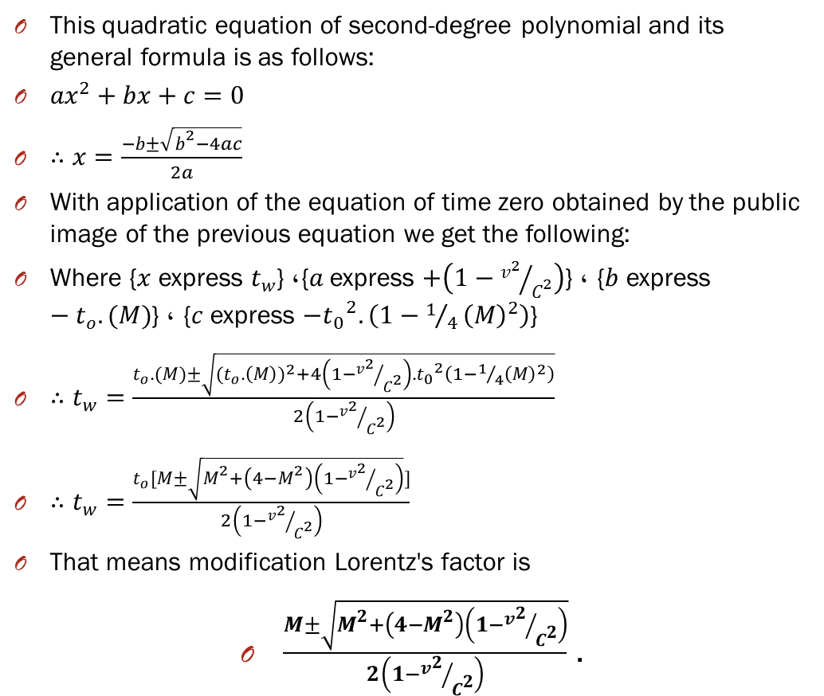
This quadratic equation of second-degree polynomial and its general formula is as follows:
$ax^{2}+bx+c=0$
$∴x=\frac{−b±\sqrt{b^{2}−4ac}}{2a}$
With application of the equation of time zero obtained by the public image of the previous equation we get the following:
Where {$x$ express $t_{w}$}, {$a$ express $+\left(1−{v^{2}}/{C^{2}}\right)$} , {$b$ express $−t_{o}.(M)$} , {$c$ express ${{−t}_{0}}^{2}.\left(1−1/4{\left(M\right)}^{2}\right)$}
$∴t_{w}=\frac{t_{o}.(M)±\sqrt{{(t_{o}.\left(M\right))}^{2}+4\left(1−{v^{2}}/{C^{2}}\right){.t_{0}}^{2}\left(1−1/4{\left(M\right)}^{2}\right)}}{2\left(1−{v^{2}}/{C^{2}}\right)}$
$∴t_{w}=\frac{t_{o}[M±\sqrt{M^{2}+\left(4−M^{2}\right)\left(1−{v^{2}}/{C^{2}}\right)}]}{2\left(1−{v^{2}}/{C^{2}}\right)}$
That means modification Lorentz's factor is
$\frac{M±\sqrt{M^{2}+\left(4−M^{2}\right)\left(1−{v^{2}}/{C^{2}}\right)}}{2\left(1−{v^{2}}/{C^{2}}\right)}$ .

Slide 14
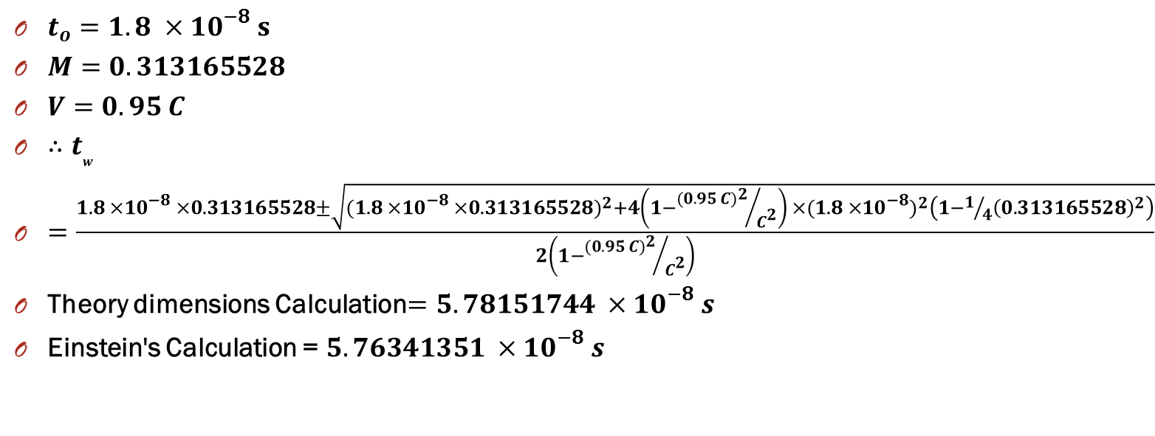
Implementation of theory of dimensions equation:
$t_{o}=1.8 ×{10}^{−8} s$
$M=0.313165528$
$V=0.95 C$
$∴t_{w}$
$=\frac{1.8 ×{10}^{−8} ×0.313165528±\sqrt{{(1.8 ×{10}^{−8} ×0.313165528)}^{2}+4\left(1−{{(0.95 C)}^{2}}/{C^{2}}\right) ×{(1.8 ×{10}^{−8})}^{2}\left(1−1/4{\left(0.313165528\right)}^{2}\right)}}{2\left(1−{{(0.95 C)}^{2}}/{C^{2}}\right)}$
Theory dimensions Calculation$=5.78151744 ×{10}^{−8} s$
Einstein's Calculation = $5.76341351 ×{10}^{−8} s$

Slide 15
Problems solved by Theory of dimensions.
1-internal Geometry for movement of photon , electron (dual nature).
2-Incident neutrino particles.
3-Black holes particles velocity.
4-There speeds faster than the speed of light more than 5-fold.
5-Solve the contradiction between the theory of relativity and quantum mechanics

Slide 16
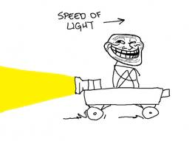
Think special

Slide 17
Reference's.
Einstein A. (1905). Zur Electrodynamik bewegter Körper. Annal. Phys. 17, 891–921. English translation: 'On the electrodynamics of moving bodies' in The Principle of Relativity. Methuen, London (1923).
Cassidy, David C.; Holton, Gerald James; Rutherford, Floyd James (2002). Understanding Physics. Springer-Verlag New York, Inc. ISBN 0-387-98756-8, Chapter 9 §9.6, p. 422
Cutner, Mark Leslie (2003). Astronomy, A Physical Perspective. Cambridge University Press. ISBN 0-521-82196-7, Chapter 7 §7.2, p. 128
Lerner, Lawrence S. (1996). Physics for Scientists and Engineers, Volume 2. Jones and Bertlett Publishers, Inc. ISBN 0-7637-0460-1, Chapter 38 §38.4, p. 1051,1052
Ellis, George F. R.; Williams, Ruth M. (2000). Flat and Curved Space-times, Second Edition. Oxford University Press Inc, New York. ISBN 0-19-850657-0, Chapter 3 §1.3, p. 28-29

